Slide 1
Health, Stress, and Coping
Chapter 13

Slide 2
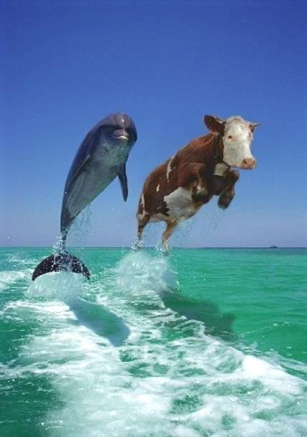
Stress
University Medical Center stress test

Slide 3
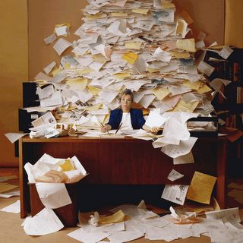
Stress
What is stress?
Good or bad?
  Eustress
    Pleasant or curative
  Distress
    Over-whelming or de-composing

Slide 4
Stress
Stress “surrender” response
Learned helplessness
Acquired inability to overcome obstacles
Stress “engagement” response
Learned optimism
Acquired ability to overcome obstacles
Undergraduate stress questionnaire (Table 13.8, page 469)
  Compare and contrast with your personal life and share with your neighbor

Slide 5
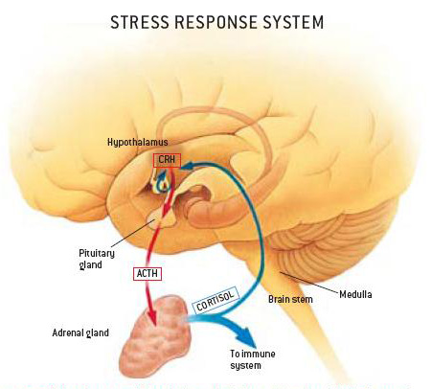
Health, Stress

Slide 6
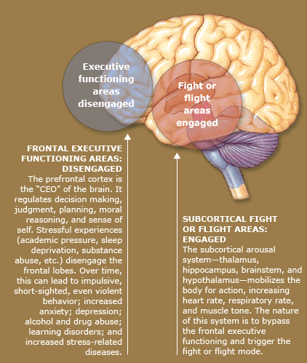
Stress
Stress and the brain

Slide 7
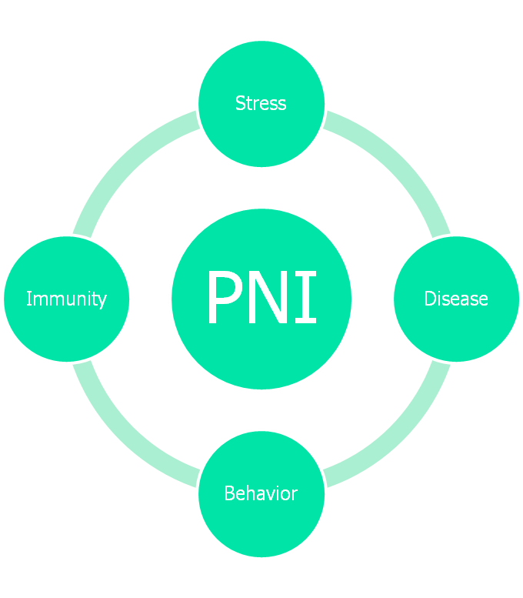
Health, Stress
Psychoneuroimmunology (PNI)
  Psycho (mind)
  Neuro (nerves)
  Immunology (immune system)

Slide 8
Health, Stress, and Coping
Stages of Stress (see Canvas)
  Phase 1: warning signs
  Phase 2: the appearance of symptoms
  Phase 3: severe stress reactions
Perception
  Threat (aggression and scapegoating) versus thrill (opportunity and growth)
  A+B=C
Coping
  Emotion-focused
  Problem-focused

Slide 9
Coping
Avoiding upsetting thoughts
  Coping statements
  Lighten up
Managing bodily reactions
  Exercise
  Meditation
  Progressive relaxation
  Guided imagery
Modifying ineffective behavior
  Slow down
  Organize
  Strike a balance
  Recognize and accept your limits
  Seek social support
  Write about your feelings

Slide 10
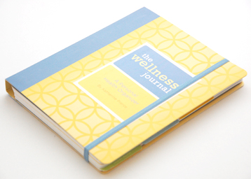
Coping
Wellness Journal
  Posted in Canvas

